Slide 1



Weekly Protein Intake #131
Brazilian Export Data, Spreads & More
July 7, 2026
Food & Beverage Team
Gustavo Troyano, CNPI
+55-11-3073-3269
gustavo.troyano@itaubba.com
Bruno Tomazetto, CNPI
+55-11-3073-3035
bruno.tomazetto@itaubba.com
Ryu Matsuyama, CNPI
+55-11-3073-3047
ryu.matsuyama@itaubba.com

Slide 2

Weekly
xxxxxxxxx
JBS – xxxx. xxxx
MBRF – xxxx. Xxxx
Minerva – xxxx. xxxx
Protein Intake
In this series, we share last week’s highlights in the protein sector. Our goal is to provide a fresh view on key data for the companies we cover, which includes the latest Brazilian SECEX export figures, as well as updated Brazilian export spreads and U.S. domestic protein spreads.

Slide 3


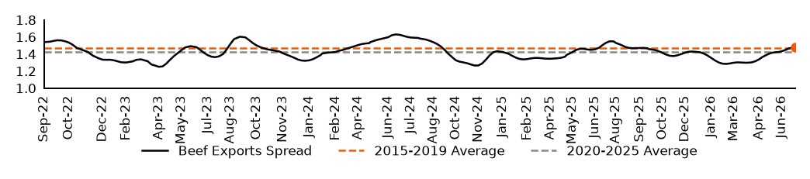
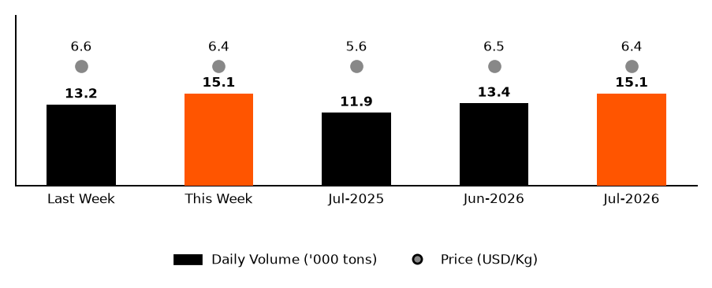
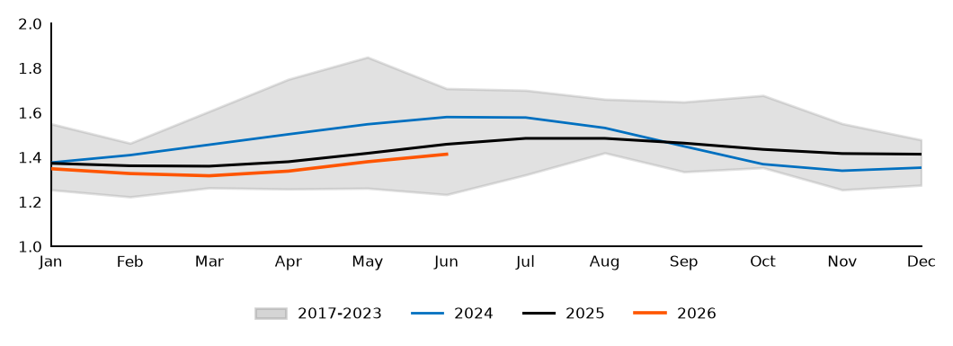
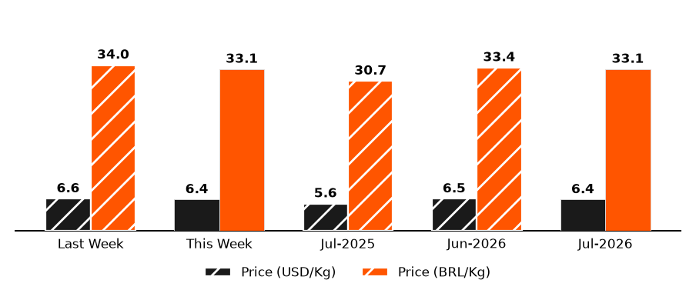

Weekly Beef Exports
Brazilian Beef Export Spreads
Export Volumes and Prices
Historical Brazilian Beef Export Spreads
Export Price Variation
Source: Itaú BBA, Bloomberg and SECEX

Slide 4


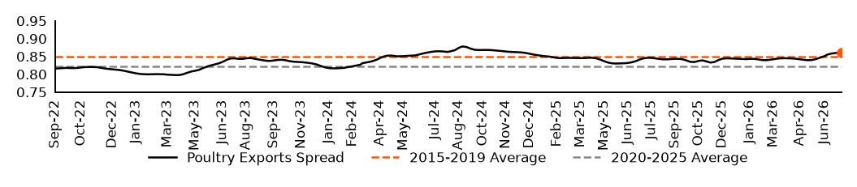
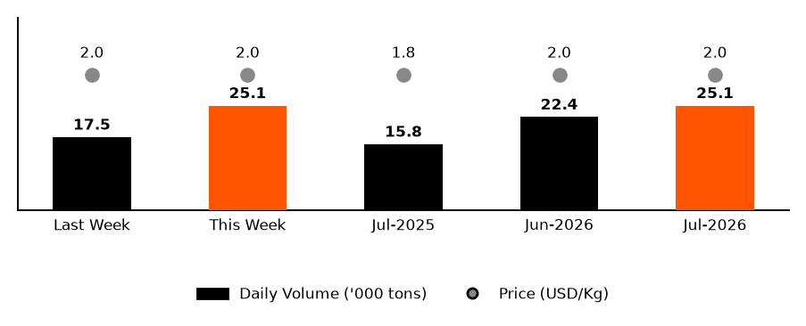
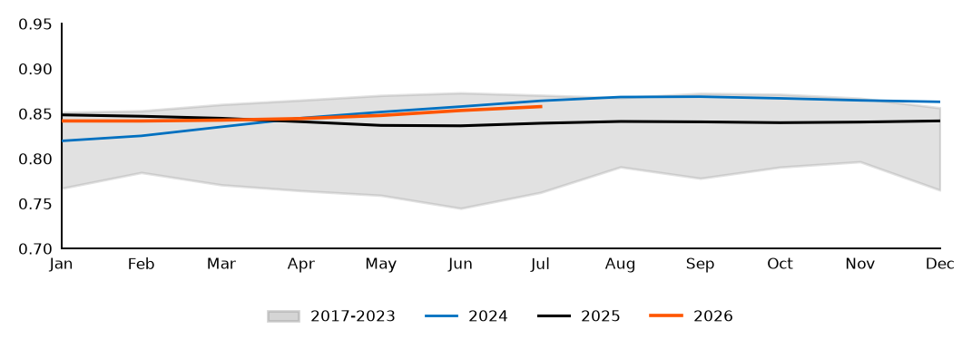
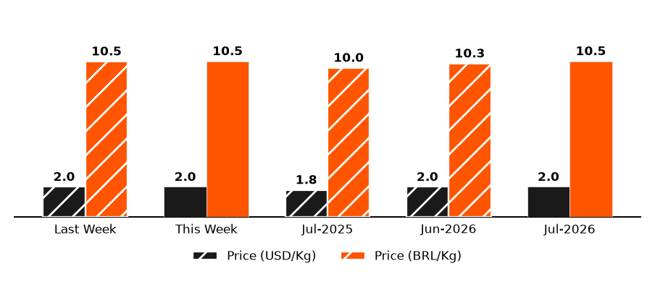
Weekly Poultry Exports
Brazilian Poultry Export Spreads
Export Volumes and Prices
Historical Brazilian Poultry Export Spreads
Export Price Variation
Source: Itaú BBA, Bloomberg and SECEX

Slide 5

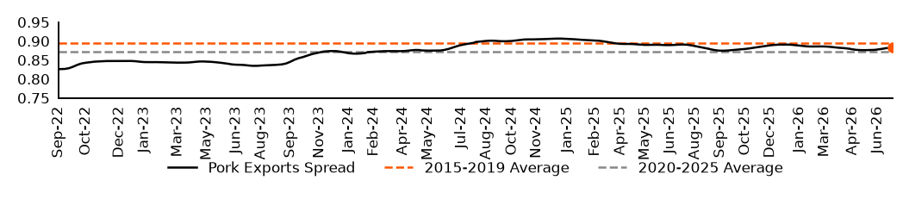
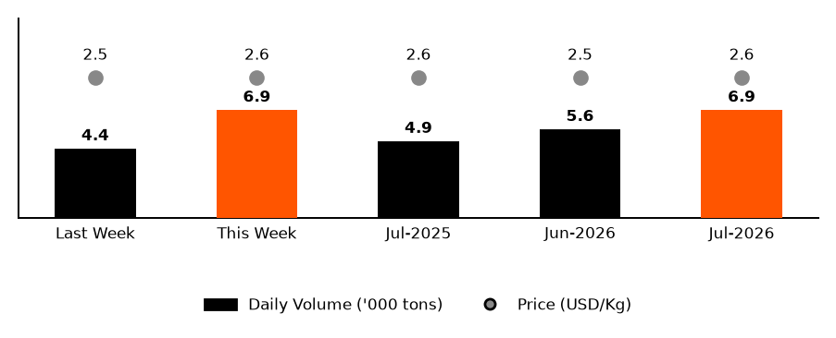
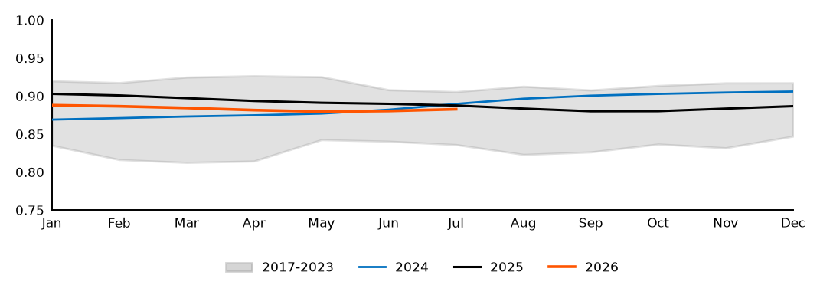
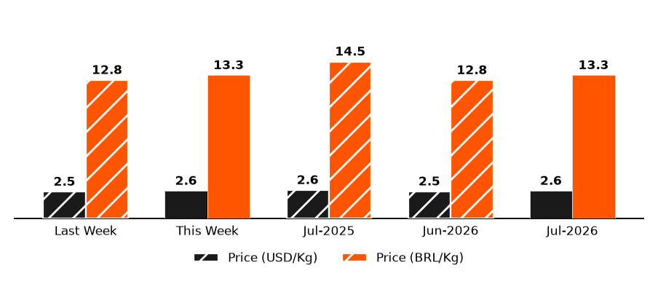
Weekly Pork Exports
Brazilian Pork Export Spreads
Export Volumes and Prices
Historical Brazilian Pork Export Spreads
Export Price Variation
Source: Itaú BBA, Bloomberg and SECEX

Slide 6


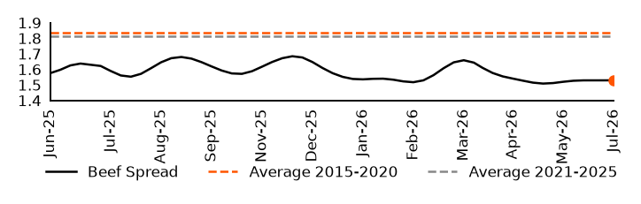
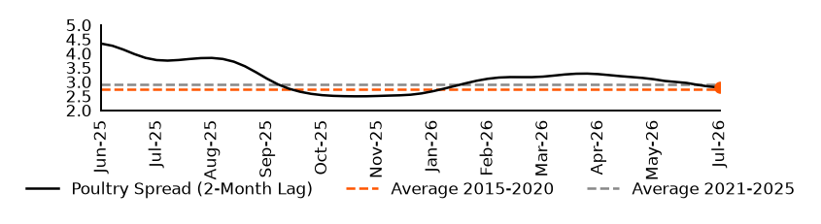
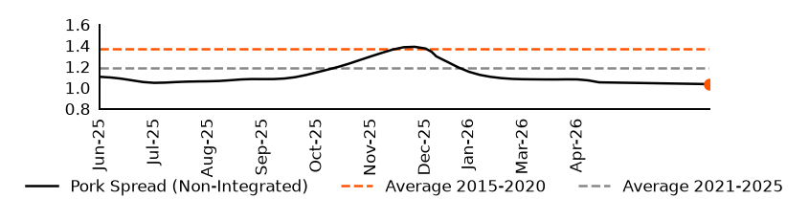
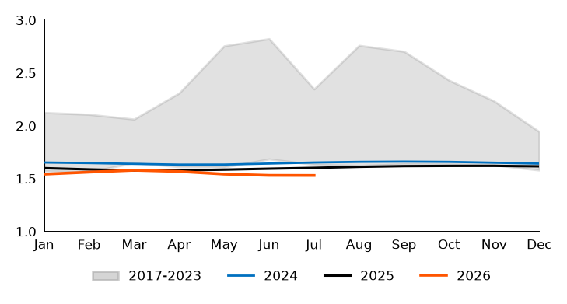
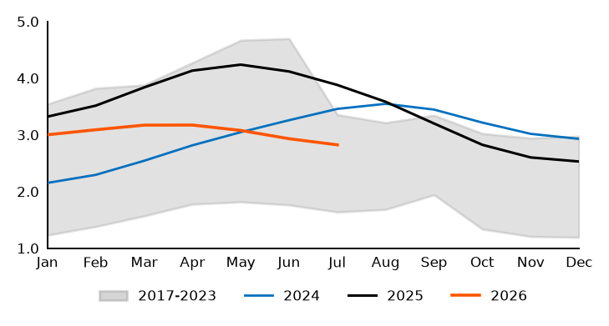
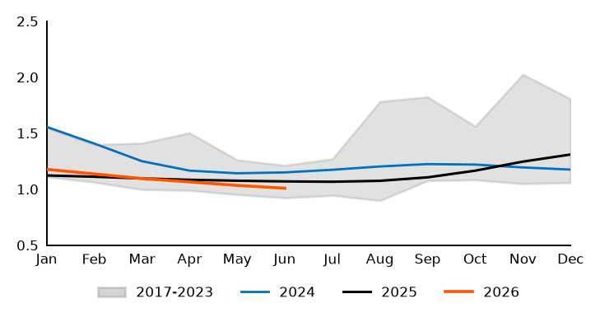
U.S. Domestic Protein Spreads
U.S. Beef Spreads
U.S. Poultry Spreads (2-Month Lag)
U.S. Pork Spreads (Non-Integrated)
Historical U.S. Beef Spreads
Historical U.S. Poultry Spreads (2-Month Lag)
Historical U.S. Pork Spreads (Non-Integrated)
Source: Itaú BBA and Bloomberg

Slide 7
Stocks Performance
Stocks Performance – Weekly (%)
Stocks Performance – MTD (%)
Stocks Performance – YTD (%)
Stocks Performance – LTM (%)
Source: Itaú BBA and Bloomberg

Slide 8
Disclaimer
Material Information
This report was prepared by Itaú Unibanco, a company regulated by the Securities and Exchange Commission (CVM), and distributed by Itaú Unibanco, Itaú Corretora de Valores S.A. and Itaú BBA. Itaú BBA is a brand used by Itaú Unibanco. This report was prepared by a securities analyst from Itaú Unibanco and is subject to Resolution 20 of the Securities and Exchange Commission (CVM).
This report does not constitute an offer to buy or sell any financial instrument or to participate in any particular trading strategy under any jurisdiction. The information herein was deemed reasonable on the date of publication and was obtained from reliable public sources. Neither Itaú Unibanco nor any of its affiliated companies (“Grupo Itaú Unibanco”) ensure or guarantee, either expressly or implicitly, that the information contained herein is accurate or complete. Furthermore, this report is not a complete or summarized representation of investment strategies, markets or developments thereof. The opinions, estimates and/or forecasts provided in this report reflect the current opinion of the analyst responsible for the content herein on the date of publication and are, therefore, subject to change without notice. The prices and availability of the financial instruments are merely indicative and subject to change beyond the control of Itaú Unibanco. The prices used for the production of this report were obtained as of the close of the relevant market. Neither Itaú Unibanco nor any of its affiliated companies are obligated to update, amend or otherwise alter this report, or to inform readers of any changes in its content, except upon termination of coverage of the securities issuers discussed herein.
The analyst responsible for preparing this document, highlighted in bold, hereby certifies that all opinions expressed in this report accurately, solely and exclusively reflect his/her personal views and opinions regarding all of the issuers and securities analyzed herein, provided in this document independently and autonomously, including from Itaú Unibanco, Itaú Corretora, Itaú BBA, and any of their affiliated companies. Whereas the personal opinions of the analyst may diverge, Itaú Unibanco, Itaú Corretora, Itaú BBA and/or any of their affiliated companies may have published or eventually publish other reports that are inconsistent and/or reach different conclusions than those provided herein.
The analyst responsible for preparing this report is not registered and/or not qualified as a survey analyst at the NYSE or FINRA, nor is such analyst in any way associated with Itau BBA USA Securities, Inc. and is, therefore, not subject to the provisions of Rule 2242 on communications with researched companies, public appearances and transactions involving securities held in a research analyst account.
Part of the analysts’ compensation is determined based on the total top line of Itaú Unibanco and some of its affiliated companies, including revenues arising from investment services and investment bank services. Nonetheless, the analyst responsible for the content in this report hereby certifies that no part of his/her compensation is or will be directly or indirectly conditioned to any specific recommendations or opinions herein.
The financial instruments and strategies discussed in this document may not be suitable for all investors and certain investors may not be eligible to purchase or participate in some or all of them. This report does not take under consideration the specific investment objectives, financial situation or needs of any particular investor. Investors who intend to purchase or trade the securities covered in this report must seek out the applicable information and documents in order to decide whether to invest in such securities. Investors must independently seek out financial, accounting, legal, economic and market guidance, based on their personal characteristics, before making any investment decision regarding the securities of the issuers analyzed in this report. Each investor must make the final investment decision based on a range of related risks, fees and commissions. In the event that a financial instrument is expressed in currencies other than the one used by the investor, exchange rate variations may adversely affect the price, value or profitability. Financial instrument yields may vary, ultimately increasing or decreasing the price or value of financial instruments, either directly or indirectly. Past performance is not necessarily indicative of future results, and this report does not ensure or guarantee, either expressly or implicitly, any possible future performance or any other aspect thereof. Itaú Unibanco and its affiliated companies may not be held liable for eventual losses, either direct or indirect, arising from the use of this report or its content. Upon using the content herein, investors undertake to irrevocably and irreparably hold Itaú Unibanco and/or any of its affiliated companies harmless against any claims, complaints, and/or losses.
This report may not be reproduced or redistributed to third parties, either in whole or in part, for any reason whatsoever, without prior written consent from Itaú Unibanco. This report and its contents are confidential.
In accordance with the rules of the Brazilian Securities and Exchange Commission, the analysts responsible for this report have described scenarios of potential conflict of interest in the “Relevant Information” chart below.
Itaú Unibanco is not party to an agreement with the issuer(s) relating to the production of this report.
The description of the internal organizational and administrative arrangements and of the information barriers in place for the prevention and avoidance of conflicts of interest with respect to the production of research reports are available at www.itaucorretora.com.br.
Material information regarding the proprietary models used by Itaú Unibanco are available at Itaú BBA Bloomberg page.
Other important regulatory information is available at https://disclosure.cloud.itau.com.br
Additional note for reports distributed in the (i) United Kingdom: This material has been prepared by Itau Unibanco S.A. for informational purposes only and it does not constitute or should be construed as a proposal for request to enter into any financial instrument or to participate in any specific business trading strategy. The financial instruments discussed in this material may not be suitable for all investors and are directed solely at Eligible Counterparties and Professional Clients, as defined by the Financial Conduct Authority. This material does not take into consideration the objectives, financial situation or specific needs of any particular client. Clients must independently obtain financial, legal, tax, accounting, economic, credit, and market advice on an individual basis, based on their personal characteristics and objectives, prior to making any decision based on the information contained herein. By accessing this material, you confirm that you are aware of the laws in your jurisdiction relating to the provision and sale of financial service products. You acknowledge that this material contains proprietary information and you are required to keep this information confidential. Itau BBA International plc (IBBAInt) exempts itself from any liability for any losses, whether direct or indirect, which may arise from the use of this material and is under no obligation to update the information contained in this material. Additionally, you confirm that you understand the risks related to the financial instruments discussed in this material. Due to international regulations, not all financial services/instruments may be available to all clients. You should be aware of and observe any such restrictions when considering a potential investment decisions. Past performance and forecast are not a reliable indicator of future results. The information contained herein has been obtained from internal and external sources, and is believed to be reliable as of the date in which this material was issued, however IBBAInt does not make any representation or warranty as to the completeness, reliability or accuracy of information obtained by third parties or public sources. Additional information relative to the financial products discussed in this material is available upon request. Itau BBA International plc has its registered offices at 100 Liverpool Street, Level 2, London, EC2M 2AT, United Kingdom, and is authorised by the Prudential Regulation Authority and regulated by the Financial Conduct Authority and the Prudential Regulation Authority (FRN 575225). For any queries please contact your relationship manager; (ii) European Economic Area: this report is distributed in the EEA by Itaú BBA Europe, S.A. (“IBBA Europe”), an affiliate of Itaú Unibanco with registered offices at Rua Tierno Galvan, Torre III, 11 piso, Lisbon, Portugal, authorised as a credit institution by the Bank of Portugal (registration number 195), and as a financial intermediary by the Portuguese Securities Market Commission – CMVM (registration number 396). This material is informational only and shall not be construed as a proposal to trade with financial instruments, nor any kind of personal recommendation of advice. This material is directed solely at Professional Clients and Eligible Counterparties (as defined by Article 4, 1, (10) and Article 30 of Directive 2014/65/EU - MiFID II), who possess the experience, knowledge and expertise to make its own investment decisions and properly assess the risks that they incur. Relevant information regarding conflicts of interest contained in this material apply to IBBA Europe as an affiliate of Itaú Unibanco. IBBA Europe does not exercise discretion as to the selection of the research reports to disseminate and exempts itself from any liability for any losses, whether direct or indirect, which may arise from the use of this material and/or its content and has no obligation to update the information contained in this material. The financial instruments/services discussed in this material may not be available to all clients and/or in their respective jurisdictions. Additional information about the financial instruments discussed in this material are available upon request (iii) USA: Itaú BBA USA Securities, Inc., a FINRA registered Broker Dealer and an SIPC member, is responsible for distributing this report and the content herein. Any U.S. investor who receives this report and intends to trade any of the securities addressed herein must do so through Itau BBA USA Securities, Inc. at 540 Madison Avenue, 24th Floor, New York, NY 10022; (iv) Brazil: Itaú Corretora de Valores S.A., a subsidiary of Itaú Unibanco S.A., is authorized by the Central Bank of Brazil and sanctioned by the CVM to distribute this report. Contact the Customer Service channel for more information: 4004-3131* (capital and metropolitan regions) or 0800-722-3131 (other locations) during business hours (BRT). If additional service is required after contacting the aforementioned channels, contact: 0800-570-0011 (business hours) or write to P.O. Box 67.600, São Paulo – SP, CEP (Postal Code) 03162-971.* (local costs apply); v) México: This research report is distributed in Mexico by Itaú Unibanco, S.A., and by third parties that may be authorized by Itaú Unibanco, S.A., from time to time. This research report shall not be construed to constitute any of the following activities under the jurisdiction of Mexico: (a) issue, market, advertise, commercialize, offer advice, recommend, solicitate and/or promote financial products and/or services of [Itaú Unibanco, S.A., its affiliates and/or subsidiaries], and/or of any third party, (b) offer to buy or sell any financial instrument or security, (c) participate in any particular trading strategy, and/or (d) intend to carry out any activity or service reserved to regulated entities by the Mexican financial laws. This research report has not been reviewed and/or approved by the Mexican National Banking and Securities Commission (Comisión Nacional Bancaria y de Valores). By reviewing this research report, you accept that you (a) are the sole responsible for taking any action or omitting to take any action in connection with the relevant securities, including but not limited to stocks, bonds, derivatives, warrants, options, and swaps, (b) must conduct your own independent appraisal regarding the relevant securities, and (c) release [Itaú Unibanco, S.A., its affiliates and/or subsidiaries] from any and all liability in connection with any action taken or omitted to be taken by you, in connection with the relevant securities.
Relevant Information – Analysts
Analysts | Disclosure Items |  |  |  | CNPI
 | 1 | 2 | 3 | 4
Gustavo Troyano |  |  |  |  | OK
Bruno Tomazetto |  |  |  |  | OK
Ryu Matsuyama |  |  |  |  | OK
*Analyst Certification
The securities analyst(s) involved in preparing this report are associated with individuals who work for the issuers addressed herein.
The securities analyst(s) spouse(s) or partner(s) hold, either directly or indirectly, on their own behalf or on behalf of third parties, stock and/or other securities discussed in this report.
The securities analyst(s), spouse(s) or partner(s) are directly or indirectly involved in the purchase, sale or intermediation of the securities discussed in this report.
The securities analyst(s), respective spouse(s) or partner(s) hold, either directly or indirectly, any financial interest related to the securities issuers analyzed in this report.
Source: Itaú BBA

